Slide 1
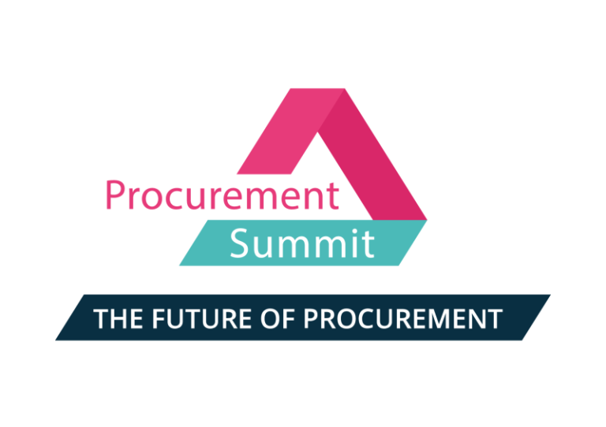


2025
HAMBURG
Rebecca Hammer
From Hype to Reality
Real AI Wins in Procurement that create true Business Value

Slide 2

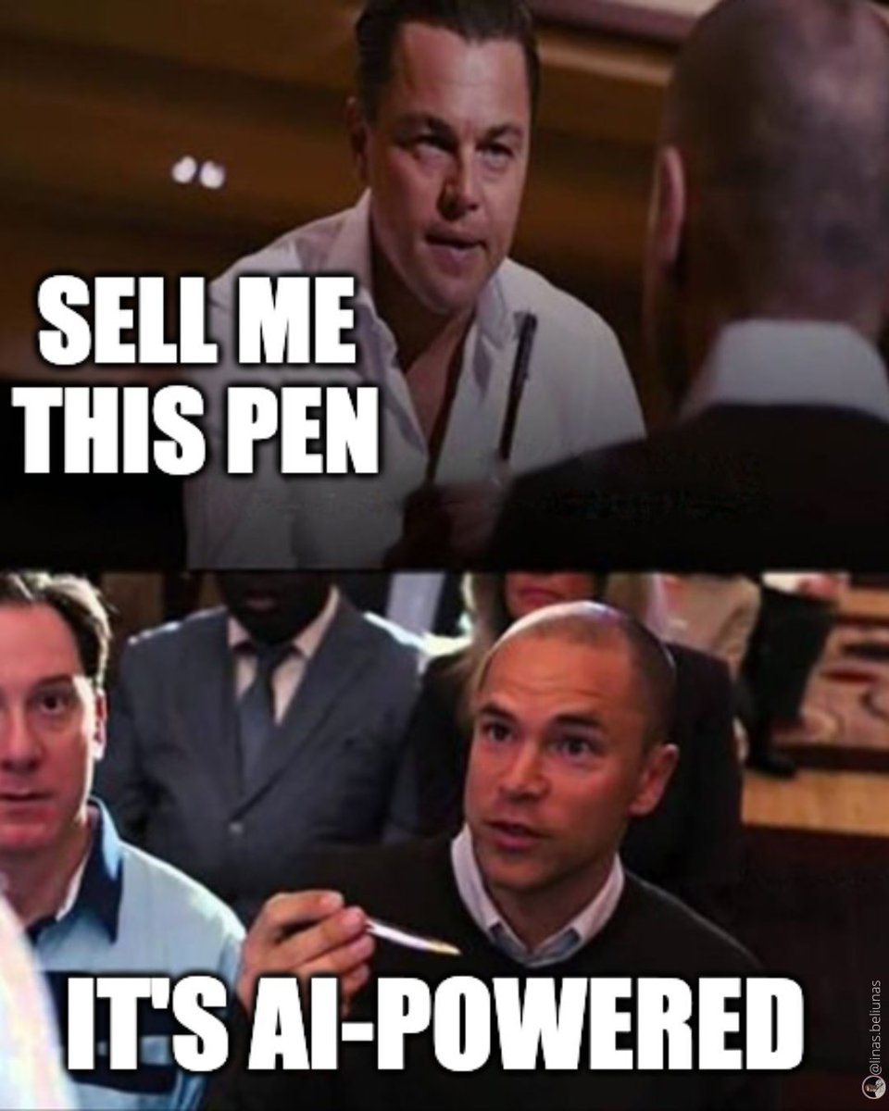
every company right now

Slide 3
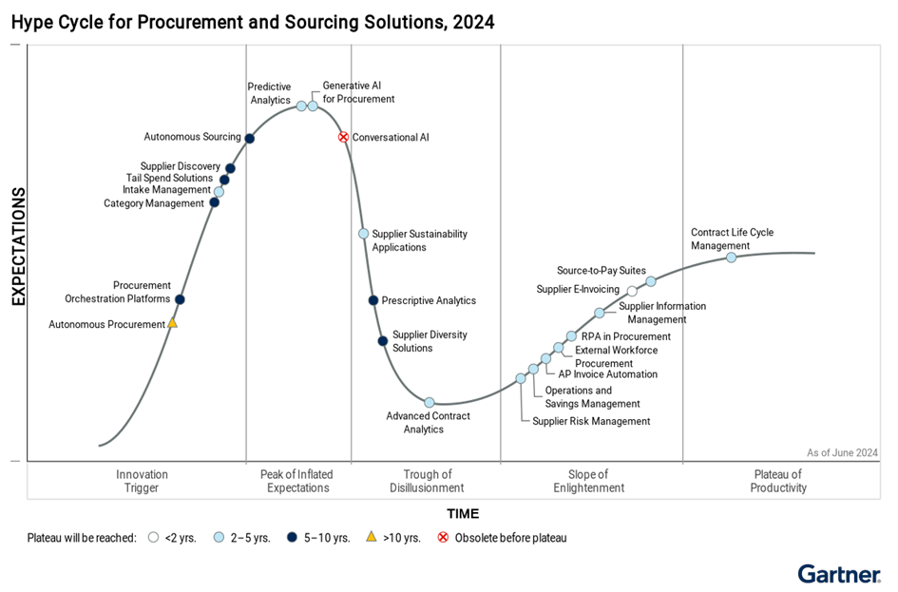
How are Procurement Organizations preparing for the (Gen)AI Revolution?
(Gen)AI as Gamechanger in Procurement
*
73% of procurement organizations have plans to implement GenAI by end of 2024
Within 2-5 years, GenAI is expected to have reached mainstream adoption with being at the highest of its productivity plateau
The Innovations included in the Hype Cycle help Procurement Leaders to set a Strategy and Timeline for Adoption!
*Source: Gartner Hype Cycle for Procurement
Notes:
Gartner Hype Cycle, GenAI auf Höhepunkt der Erwartung und es wird davon ausgegangen, dass genAI inerhalb von 2-5 jahren das mainstream erreichen wird

Slide 4
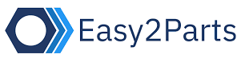



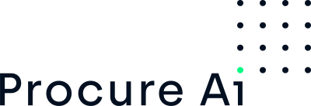







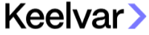







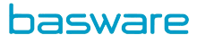







What the (Vendor) Market has to offer for (Gen)AI in Procurement
Heterogeneous Ai Vendor Market
$430M
2028
GenAI in procurement market size has grown exceptionally in recent years with already showing a
compound annual growth rate of 28,7% compared to 2023
$160M
$120M
2024
2023
SOURCE-TO-CONTRACT
PROCURE-TO-PAY
STRATEGIC
SOURCING
SUPPLIER
MANAGEMENT
CONTRACT
MANAGEMENT
RISK
MANAGEMENT
PURCHASING
ANALYTICS
SUSTAINABILITY
ORDER
MANAGEMENT
INVOICING
PAYMENT
FRAUD DETECTION
USE CASE ENABLER
Specialized Software for Procurement, either purely (Gen)AI-driven or including (Gen)AI features
THE SUITES
Comprehensive integration of (Gen)AI features, Use Cases and functionalities across processes in scope

Slide 5
What are the Use Cases showing most Potential for Procurement?
Our view on value-driven use cases in procurement
Usage of (Gen)AI
Envisioned improvements
over the next 12-18 months
38%
40%
33%
30%
35%
31%
31%
25%
25%
30%
28%
24%
27%
25%
15%
15%
21%
23%
SOURCE-TO-CONTRACT
PROCURE-TO-PAY
STRATEGIC
SOURCING
SUPPLIER
MANAGEMENT
CONTRACT
MANAGEMENT
RISK
MANAGEMENT
PURCHASING
ANALYTICS
SUSTAINABILITY
ORDER
MANAGEMENT
INVOICING
PAYMENT
Complex analysis of sourcing events
Understand and score open-text feedback on supplier questionnaires
Data extraction, clause classification & contract summarization
N-tier supplier / supply chain risk to predict supply disruptions
GenAI-driven Procurement Analytics
Automated data preparation for e.g. CSDDD and LKSG
Co-Pilot for requisitioners regarding guided buying
26
AP Invoice Automation
GenAI-powered fraud detection and -prevention
1
4
7
11
14
19
23
29
Sourcing bot for index-based prices, using forecast and
other data sources to suggest right time to source
15
Automated category mapping
27
NLP to Invoice
Intelligent payment routing
2
GenAI-created supplier risk profiles w/ market and real-time data
20
AI-based sustainability compliance monitoring
Autonomous Procurement of spare parts
30
Supplier n-tier mapping to model network
AI-based document reading
12
24
28
AI-assisted invoice dispute management
5
8
AI-driven credit scoring
16
Autonomous data cleansing
31
9
Semantic Search & Contract Analysis
21
Alternative materials based on CO2 Footprint
25
Predictive demand forecasting
6
AI-based Supplier Performance control
Risk-based decision-making
17
Gen(AI)-suggested cost improvements
32
Automated compliance checks
3
Savings generation by finding similar material with AI
13
10
Extraction & contractual obligations management
Automated Tail Spend Categorization
22
Optimized shipping routes and -consolidation
18
10
Risk Assessment & Co-Authoring

Slide 6
What are the Use Cases showing most Potential for Procurement?
(Our view on value-driven use cases in procurement
1
Complex analysis of sourcing events
17
Gen(AI)-suggested cost improvements
CALCULATED RISK
LIKELY WINS
2
Sourcing bot for index-based prices, using forecast and other data sources to suggest right time to source
18
Automated Tail Spend Categorization
3
19
Automated data preparation for e.g. CSDDD and LKSG
3
Savings generation by finding similar material with AI
16
23
4
Understand and score open-text feedback on supplier questionnaires
20
AI-based sustainability compliance monitoring
8
29
9
14
5
Supplier n-tier mapping to model network
21
Alternative materials based on CO2 Footprint
11
26
6
AI-based Supplier Performance control
22
Optimized shipping routes and -consolidation
17
19
15
7
Data extraction, clause classification & contract summarization
VALUE
24
2
1
23
Co-Pilot for requisitioners regarding guided buying
7
18
12
8
AI-based document reading
5
6
24
Autonomous Procurement of spare parts
22
4
9
Semantic Search & Contract Analysis
13
Extraction & contractual obligations management
25
Predictive demand forecasting
20
10
32
31
10
21
11
N-tier supplier / supply chain risk to predict supply disruptions
26
AP Invoice Automation
27
25
30
NLP to Invoice
28
27
12
GenAI-created supplier risk profiles w/ market and real-time data
28
AI-assisted invoice dispute management
13
Risk-based decision-making
29
GenAI-powered fraud detection and -prevention
14
GenAI-driven Procurement Analytics
30
Intelligent payment routing
MARGINAL GAINS
15
Automated category mapping
31
AI-driven credit scoring
16
Autonomous data cleansing
32
Automated compliance checks
FEASIBILITY

Slide 7
What are the Use Cases showing most Potential for Procurement?
Our view on value-driven use cases in procurement
1
Complex analysis of sourcing events
17
Gen(AI)-suggested cost improvements
CALCULATED RISK
LIKELY WINS
2
Sourcing bot for index-based prices, using forecast and other data sources to suggest right time to source
18
Automated Tail Spend Categorization
3
19
Automated data preparation for e.g. CSDDD and LKSG
3
Savings generation by finding similar material with AI
16
23
4
Understand and score open-text feedback on supplier questionnaires
20
AI-based sustainability compliance monitoring
8
29
9
14
5
Supplier n-tier mapping to model network
21
Alternative materials based on CO2 Footprint
11
26
6
AI-based Supplier Performance control
22
Optimized shipping routes and -consolidation
17
19
15
7
Data extraction, clause classification & contract summarization
VALUE
24
2
1
23
Co-Pilot for requisitioners regarding guided buying
7
18
12
8
AI-based document reading
5
6
24
Autonomous Procurement of spare parts
22
4
9
Semantic Search & Contract Analysis
13
Extraction & contractual obligations management
25
Predictive demand forecasting
20
10
32
31
10
21
11
N-tier supplier / supply chain risk to predict supply disruptions
26
AP Invoice Automation
27
25
30
NLP to Invoice
28
27
12
GenAI-created supplier risk profiles w/ market and real-time data
28
AI-assisted invoice dispute management
13
Risk-based decision-making
29
GenAI-powered fraud detection and -prevention
14
GenAI-driven Procurement Analytics
30
Intelligent payment routing
MARGINAL GAINS
15
Automated category mapping
31
AI-driven credit scoring
16
Autonomous data cleansing
32
Automated compliance checks
FEASIBILITY

Slide 8
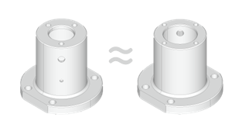




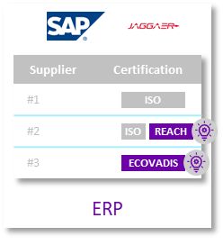


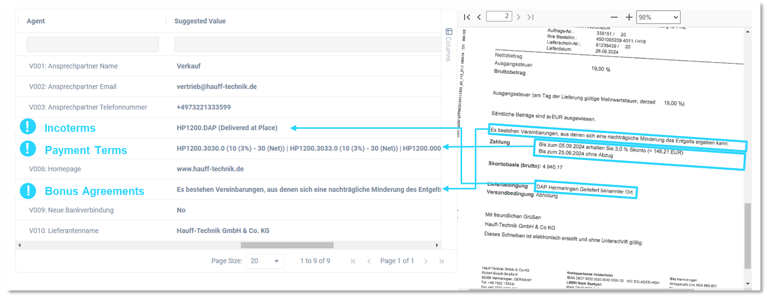


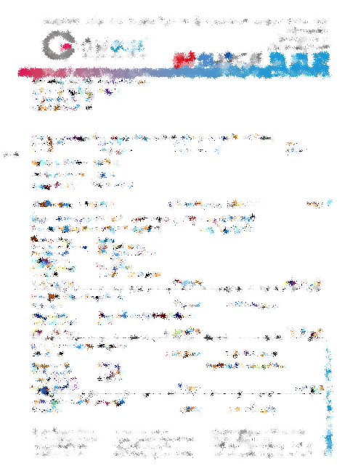
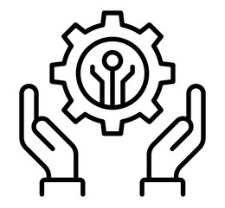

Three top Use Cases that already worked for our clients and created tangible value
Selected use Cases with selected clients
3
9
MATERIAL HARMONIZATION
SAVINGS GENERATION WITH SIMILAR PARTS
23
CONTRACT READING & -ANALYSIS
German Energy Provider
German Manufacturer
CO-PILOT FOR REQUISITIONERS WITH GUIDED BUYING
German Manufacturer
AI-powered identification of same- & similar parts
Price Analysis and Sourcing Events
Material harmonized
Savings achieved
Supply strategy in place
AI-based document reading & understanding
AI-matching and comparison with ERP data
Data provision and -correction
Coupa implementation with elaborated Change Mgmt. Approach
AI-powered guided buying and user support
Improved process efficiency
High adoption rate
~12% Savings achieved
~300k € savings in Pilot
Up to 7m € savings in productive usage

Slide 9

Use Case: CONTRACT READING & -ANALYSIS
9
Selected use Cases with selected clients
1.) Crawling of documents w/ OCR
AI-Data-Agent
(e.g. Supplier Certifications)
Unstructured data in invoices

Slide 10

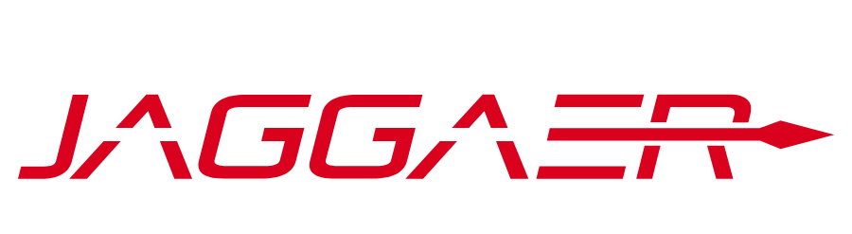

Use Case: CONTRACT READING & -ANALYSIS
9
Selected use Cases with selected clients
1.) Crawling of documents w/ OCR
2.) AI-based document understanding
AI-Data-Agent
(Supplier Certifications)
3.) AI-based data structuring
4.) AI-Matching & comparison w/ ERP
DQN
ERP
ISO
Supplier | Certification
1
2
3
Supplier | Certification
#1
#2
#3
ISO
ISO
N/A
REACH
ECOVADIS
Unstructured data in invoices

Slide 11
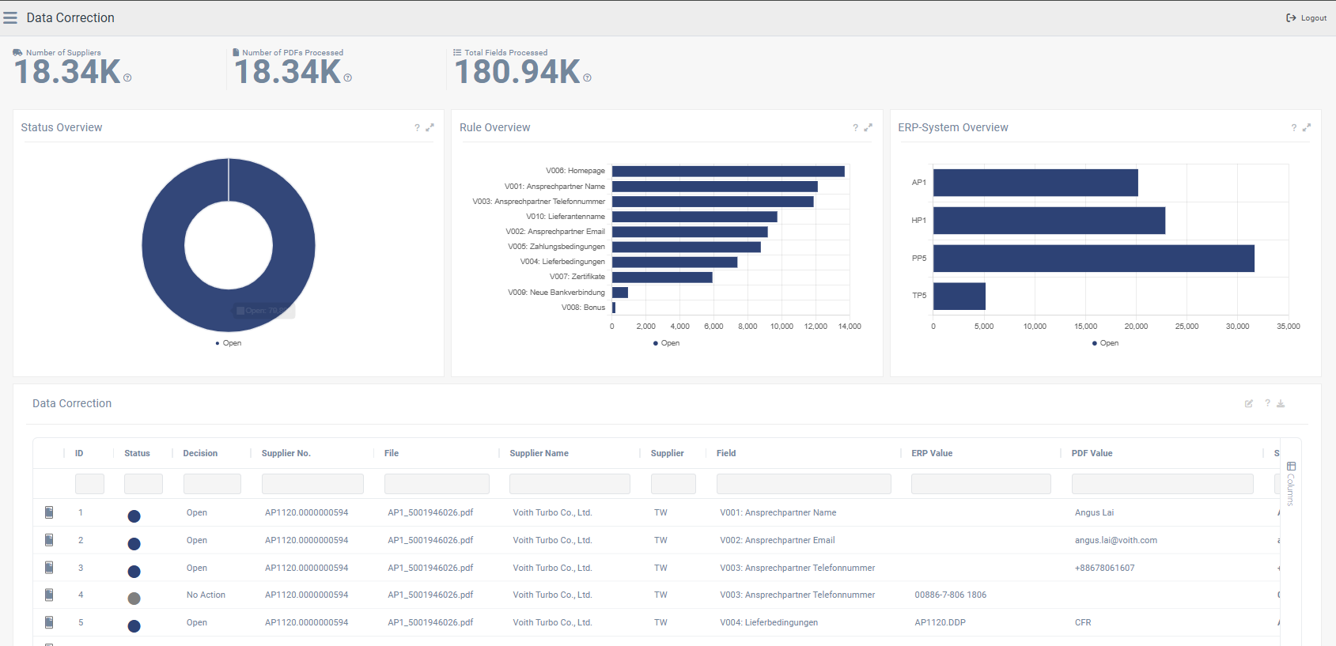

Use Case: CONTRACT READING & -ANALYSIS
9
Selected use Cases with selected clients
1.) Crawling of documents w/ OCR
2.) AI-based document understanding
AI-Data-Agent
(Supplier Certifications)
3.) AI-based data structuring
4.) AI-Matching & comparison w/ ERP
5.) AI-based identification of findings
DQN
ERP
6.) Alerting & reporting
Supplier | Certification
#1
#2
#3
ISO
7.) Data provision
ISO
REACH
ECOVADIS
Unstructured data in invoices

Slide 12
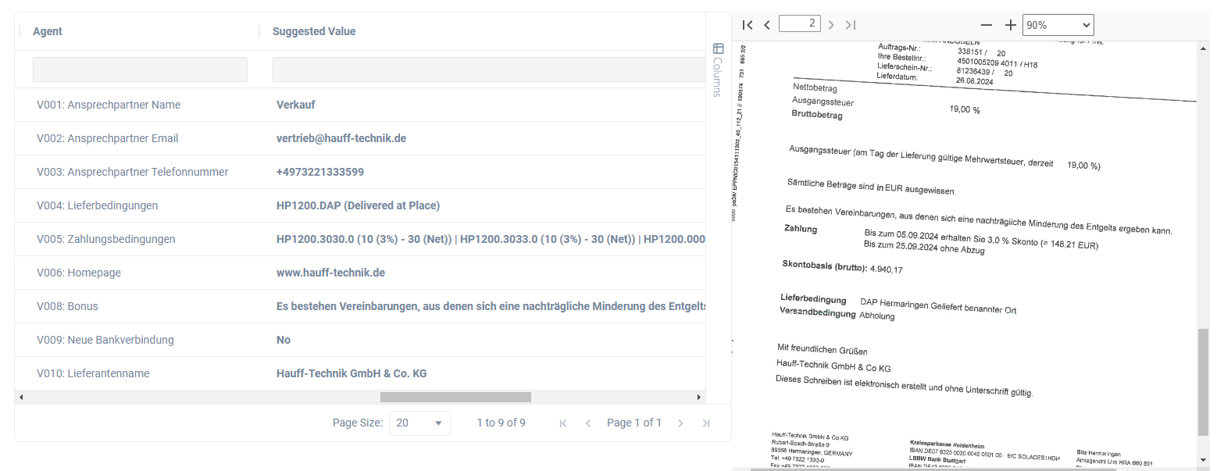


Use Case: CONTRACT READING & -ANALYSIS
9
Selected use Cases with selected clients
!
Incoterms
!
Payment Terms
!
Bonus Agreements
%
Processing of Scanned Documents with Low Quality
Multi-lingual
Data Processing
Retrieval of Bonus Agreements
for Proactive Controlling

Slide 13

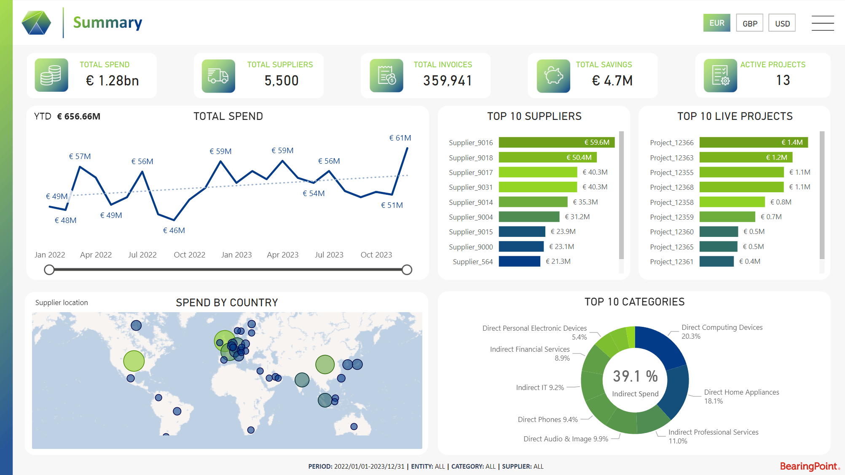
Know Your Spend
Identify Saving Opportunities
Reduce Cost
Client Use Case
16k PD
workload
reduced
Client Use Case
7M€
potential savings
identified
100%
spend
transparency

Slide 14
Empower Procurement with Precision: Transform Data into Strategic Insights
AI-Driven Spend Analytics by BearingPoint
Invoice Data Extraction & Classification
Contract Analysis
Invoice Metadata Extraction: Efficiently extract metadata from bulk invoices.
Automated classification of a commercial taxonomy against a spend profile, leveraging AI.
Contract metadata supports the extraction and review of payment terms, expiry dates, and cost-saving initiatives.
Supports contracted spend across the portfolio, helping drive key compliance checks.
Savings Analytics & Tracking
Supplier Risk & Compliance
Tracking on savings initiatives for a procurement organisation supporting both BAU and dedicated project activities
Savings realisation: monitoring and tracking of how savings realised over the contract
Procurement health KPIs: assessing the how a procurement function is performing, assessing KPIS such as spend under contract.
Driving greater compliance across the supplier base, reviewing VAT IDs, sanction lists.
Supplier Harmonisation
Similar Parts Analysis
Normalises supplier naming conventions and details across ERP systems.
Supplier harmonisation process, ensuring suppliers are mapped to parent and child entities to support supplier aggregation
Match parts across a direct material portfolio, highlighting areas of savings opportunities.
Cost Savings Opportunities: This review identifies areas for immediate savings, leveraging the best prices negotiated.

Slide 15
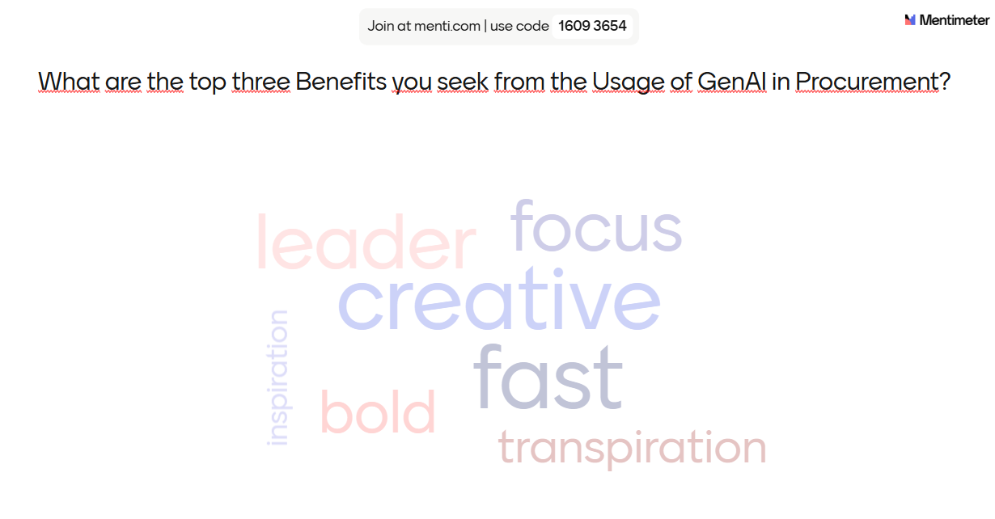
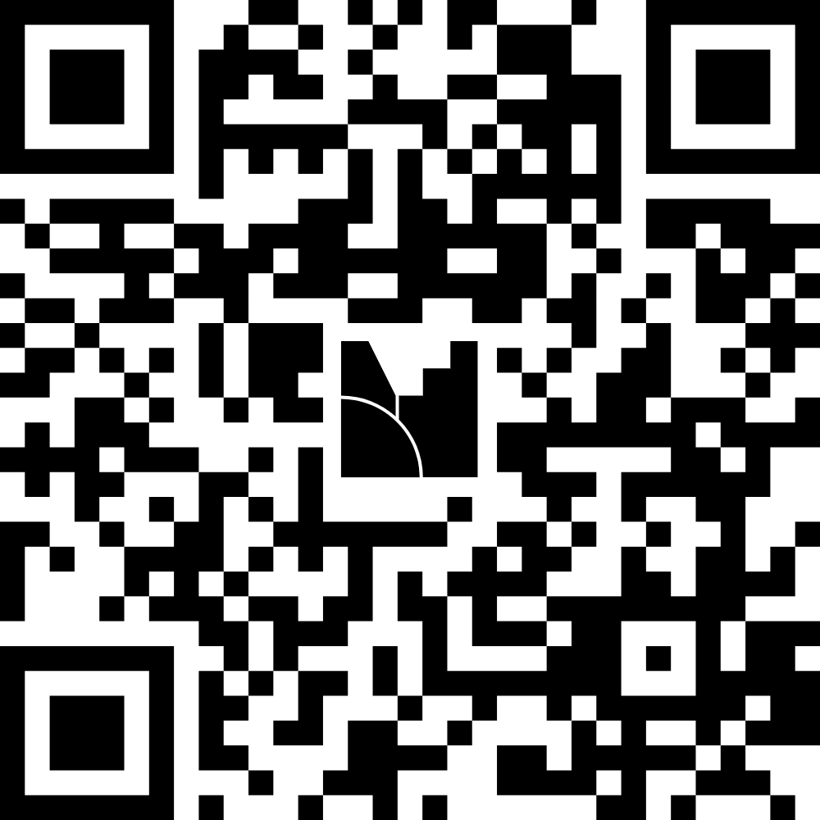
What are the top three Benefits you seek from the Usage of GenAI in Procurement?
MENTI SURVeY
https://www.menti.com/alwh8grsop6s

Slide 16
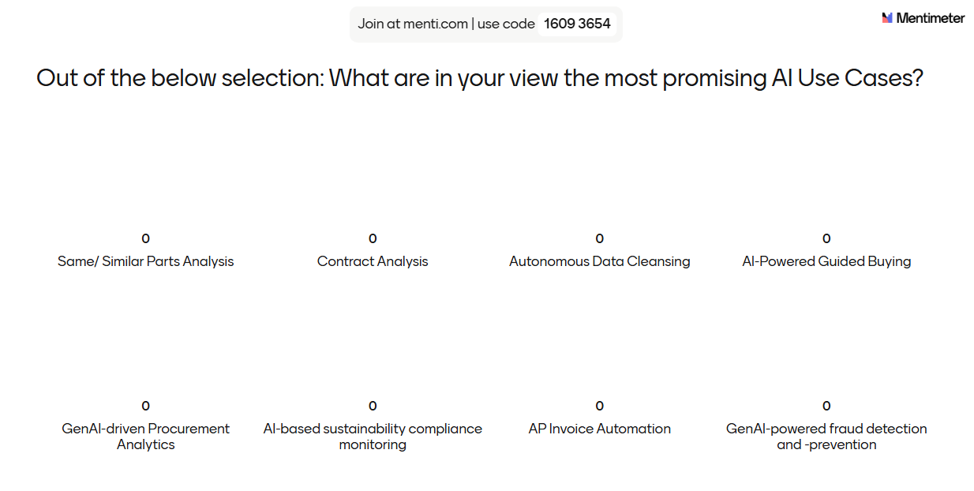
What are the most promising AI Use Cases for Procurement?
MENTI SURVeY
https://www.menti.com/alwh8grsop6s

Slide 17
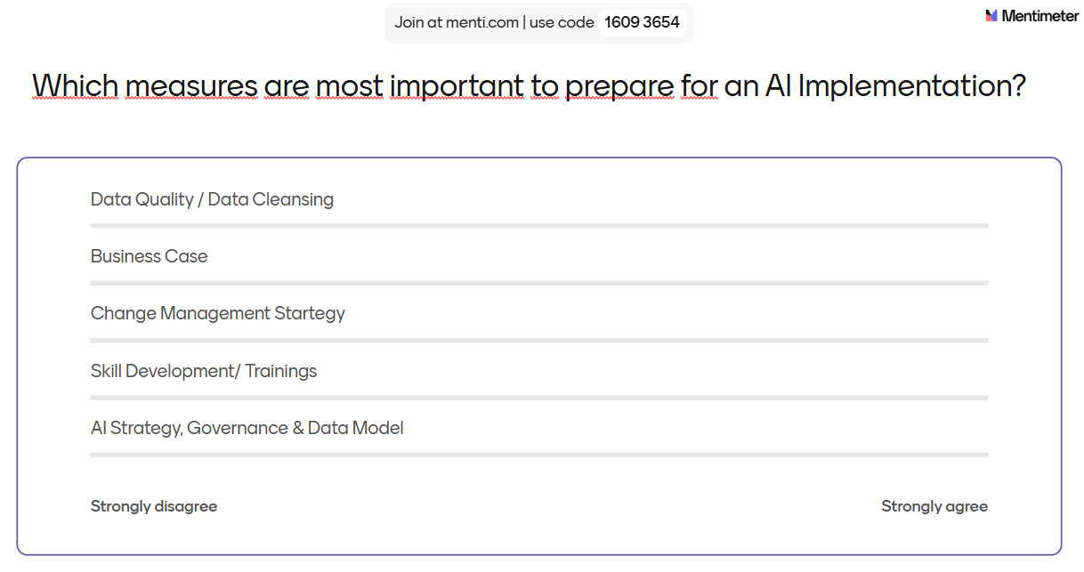
Which measures are most important to prepare for an AI Implementation?
MENTI SURVeY
https://www.menti.com/alwh8grsop6s

Slide 18

From Hype to Reality – Let‘s boost value in procurement!
Proven AI use cases in procurement are delivering measurable value—from cost savings to increased efficiency—making AI not just a future concept, but a present-day competitive advantage
VALUE
Successful AI adoption requires careful consideration of data quality, change management, and strategic alignment—it's not just about technology, but transforming processes and people.
FOUNDATION
By focusing on practical use cases and implementation best practices, organizations can unlock AI’s full potential to drive smarter, faster, and more resilient procurement operations.
POTENTIAL

Slide 19


Contact
Rebecca Hammer
Senior Manager
BearingPoint GmbH
Speicherstr. 1
60327 Frankfurt am Main
Germany
M +49 151 2031 1187 www.bearingpoint.com
Rebecca.hammer@bearingpoint.com

